Slide 1
KANGAROO BAY
COMMUNITY & ECONOMIC DEVELOPMENT PROJECT
A case study:
Integration of community health & well-being principles into an urban development project.
Greg Walker
Economic Development Officer
Clarence City Council
24 May 2016
Notes:
My presentation today will focus on how the Council’s health and well-being policies and principles – outlined earlier today – can be driven down into the hard-nosed reality of civil infrastructure projects.

Slide 2
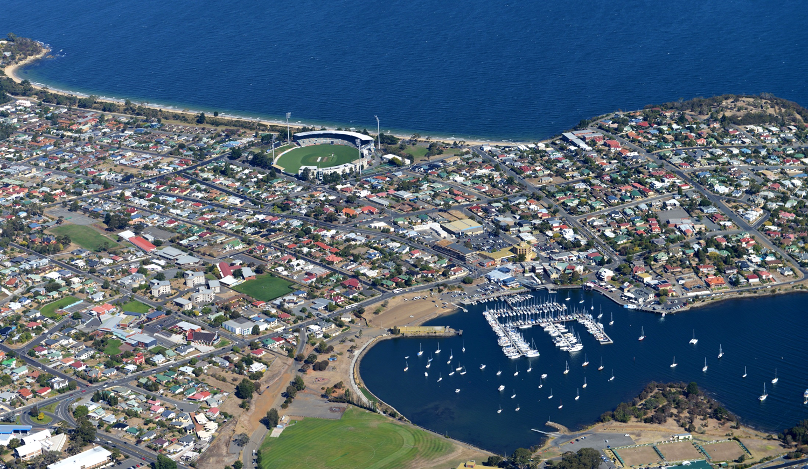
BACKGROUND - KANGAROO BAY STRATEGIC PROJECT
Notes:
COUNCIL’S STRATEGIC PROJECT
The Kangaroo Bay development project is a long-standing strategic project of Clarence Council.
The project aims to establish Kangaroo Bay as a focal point for the City and significant waterfront visitor, leisure, and inner urban precinct in Tasmania.
Council has noted the success other cities in Australia and overseas have had in improving city liveability and vitality through enhancement of their urban waterfronts; such as Geelong, Brisbane, Melbourne and Auckland, and others.

Slide 3
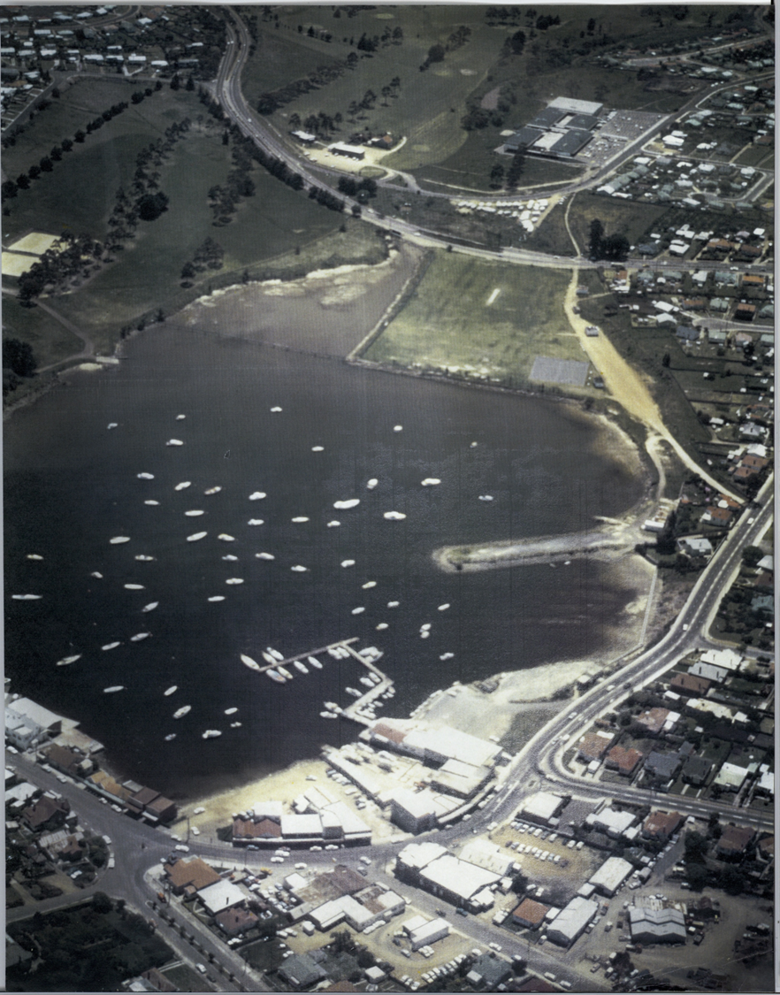
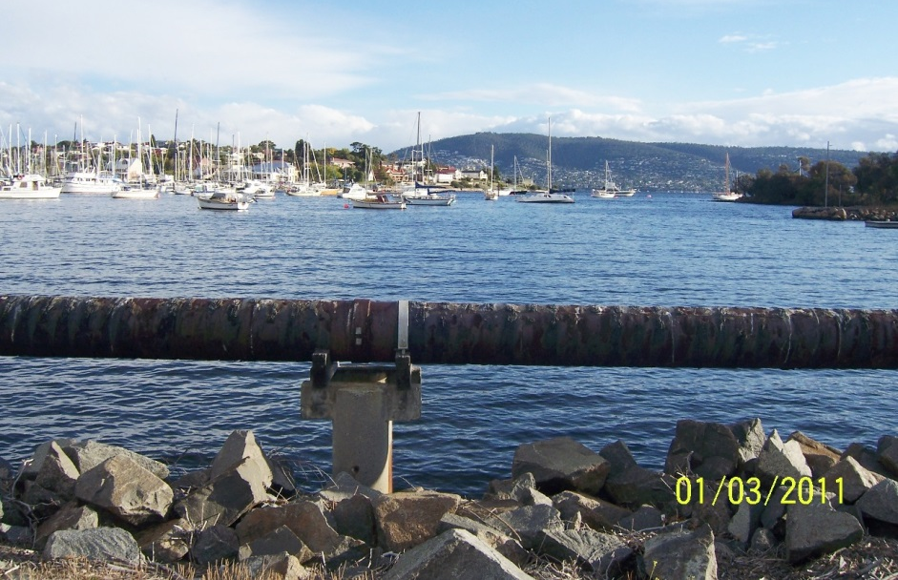
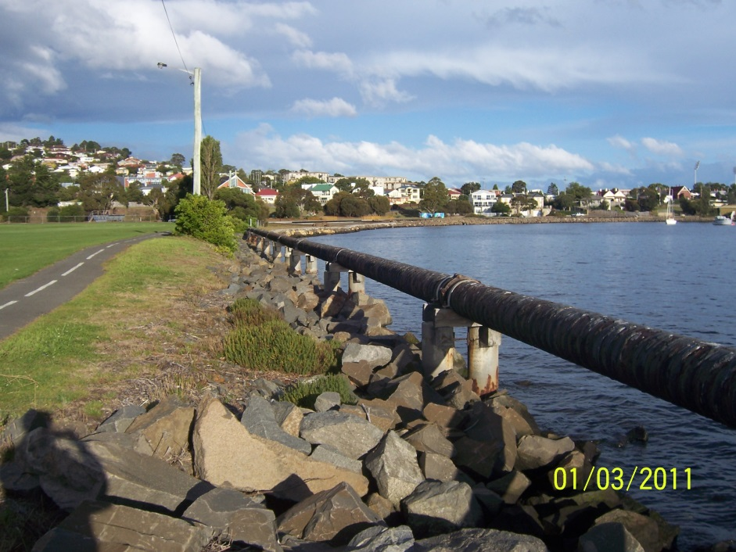
KANGAROO BAY - HISTORY
Notes:
HISTORY
The potential for Kangaroo Bay to become a focal point for the city has perhaps not always been recognised.
In the early days the bay was used a municipal tip, and the idea of putting an above ground sewer pipe around the waterfront was probably not given a second thought.
Historically commercial and residential development in Bellerive Village and along Cambridge Road has turned its back on the bay.
A reorientation of development towards the waterfront has been an objective of the planning that has been undertaken for the area.

Slide 4
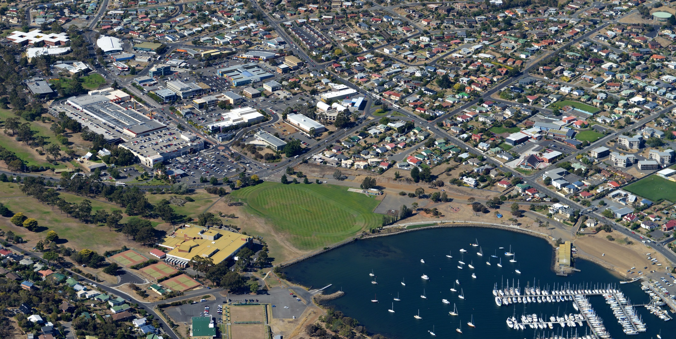
EXISTING ACTIVE RECREATION ASSETS
GOLF
SQUASH
CRICKET
FOOTBALL
TENNIS
SAILING
BOWLS
Notes:
EXISTING ACTIVE RECREATION ASSETS
Moving forward to the present day – it is clear that Eastern shore people love their sport!
In undertaking the planning for the future of Kangaroo Bay it was clear that there is no shortage of active recreation opportunities.
Remarkably, within a few hundred metres of the largest shopping centre complex in Tasmania it is possible to undertake golf, tennis, lawn bowls, cricket, football, sailing and squash; with a public indoor pool also nearby.

Slide 5
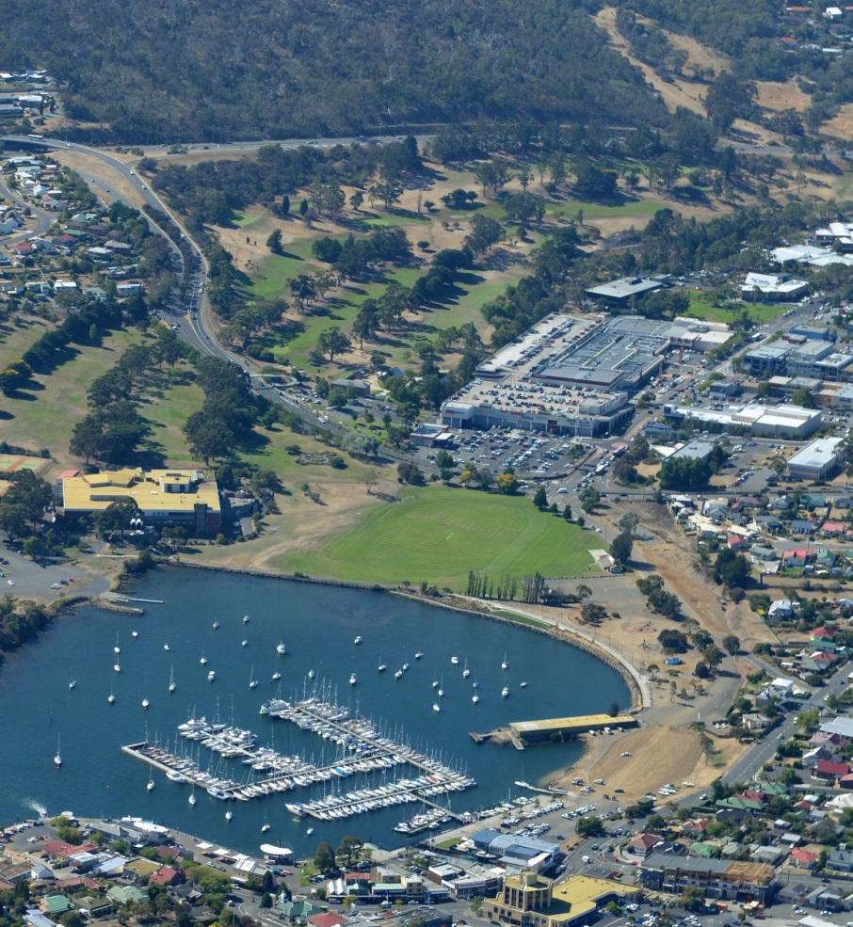
BUT – WHAT IS MISSING?
Despite the abundance of sporting facilities in the area, Kangaroo Bay was still not functioning well as a social & community hub and activity centre.
What was missing?
precinct access and connectivity
vitality associated with commercial hospitality and leisure services
quality landscaping and amenity
age friendly opportunities - for youth, older persons and families
transport connections (buses & ferries)
a sense of “place” as a destination
perhaps something “iconic” as a focal point to the bay?
Notes:
Despite the abundance of sporting facilities in the area, Kangaroo Bay was not functioning well as a community focal point and activity centre.
What was missing?
precinct access and connectivity
vitality associated with commercial hospitality and leisure services
quality landscaping and amenity
age friendly opportunities - for youth, older persons and families
transport connections (buses & ferries)
a sense of “place” as a destination
perhaps something “iconic” as a focal point to the bay?
It will not be possible in the time we have today to discuss all of those elements – but I would like to talk about the action we have taken in regard to a few of them.

Slide 6
ACCESS & CONNECTIVITY
Notes:
ACCESS & CONNECTIVITY
Kangaroo Bay Drive
Alma Street
Pembroke Place
Foreshore promenade and multi-purpose pathway
Kangaroo Bay Rivulet

Slide 7
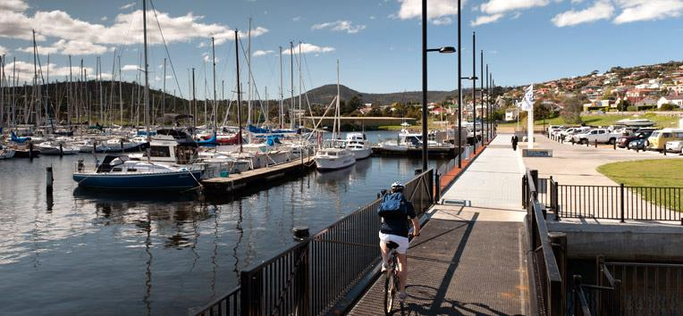
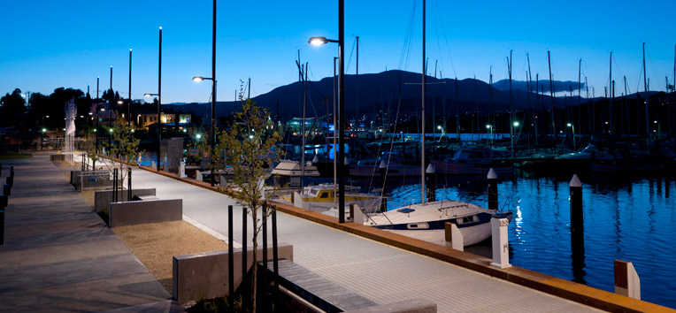

Slide 8
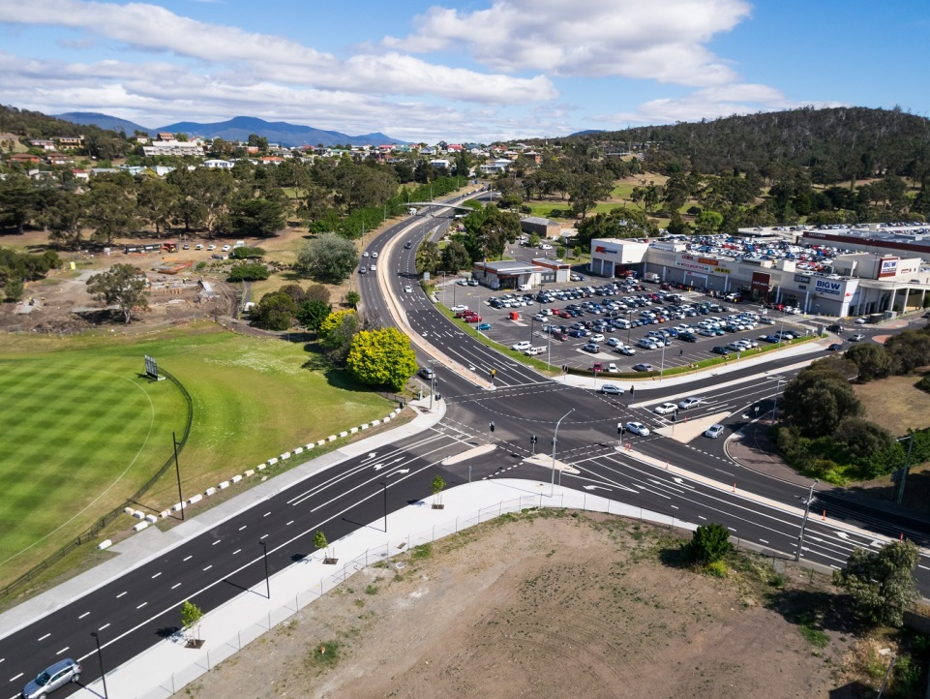
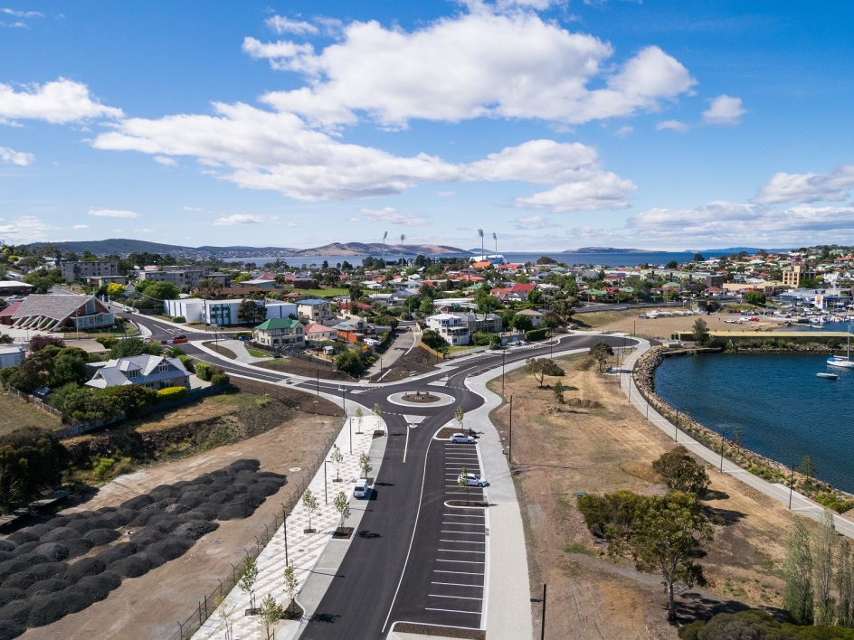
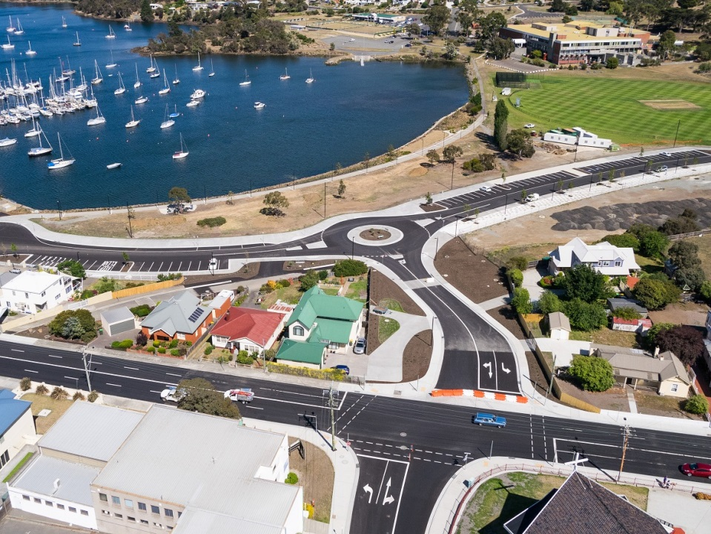
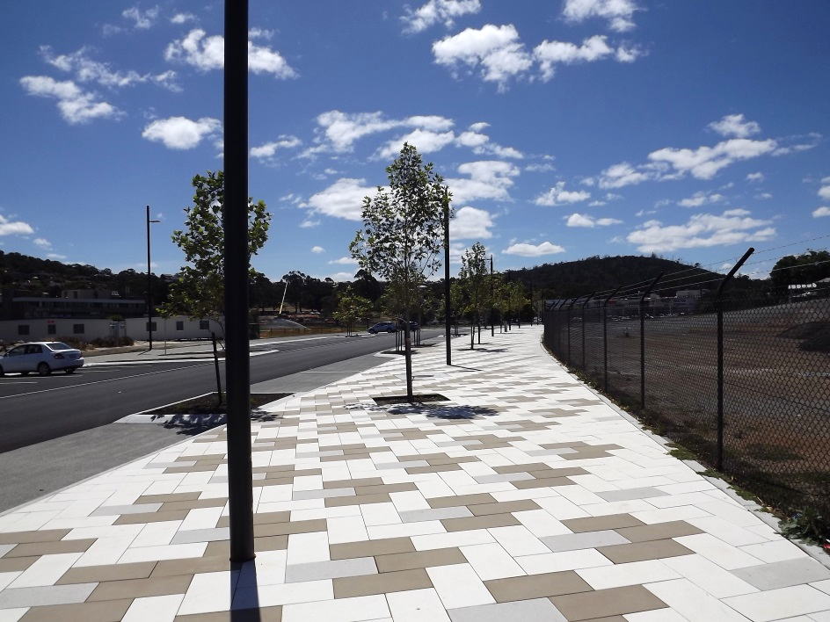

Slide 9
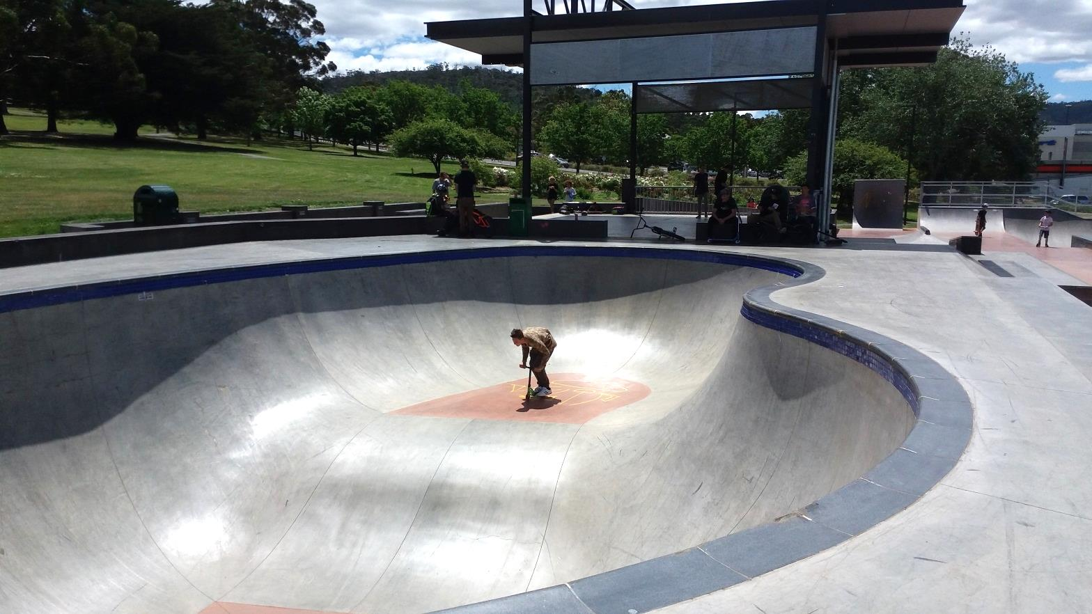
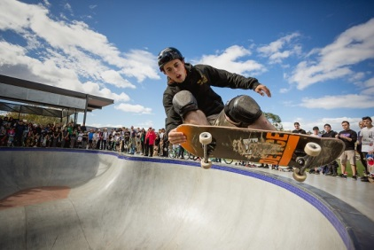
AGE & FAMILY FRIENDLY ACTIVITIES – PASSIVE & ACTIVE
Kangaroo Bay Youth Plaza - Skate park
Notes:
At Kangaroo Bay it was recognised that more youth related facilities and activities should be provided:
The idea for a skate park started back in 2010 when Council was presented with a petition from over 400 young people wanting a facility for skaters in a central location in the city.
A location for the skate park was then identified through the Kangaroo Bay Urban Design Plan process.
The design of the skate park includes an international standard competition street course and bowl. This skate park rivals other high quality skate parks in Australia. It is hoped that the facility can host state and national skate events in the future.
The concept of the youth plaza is of course much broader than the actual skating activity, and is also about youth participation and positive engagement etc.

Slide 10
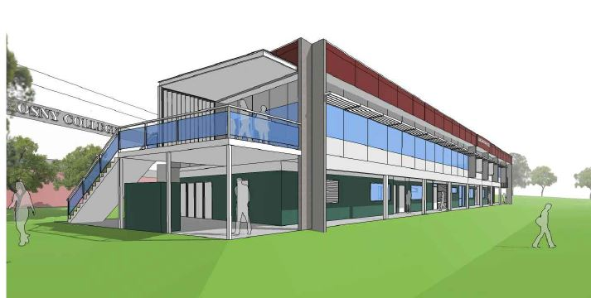
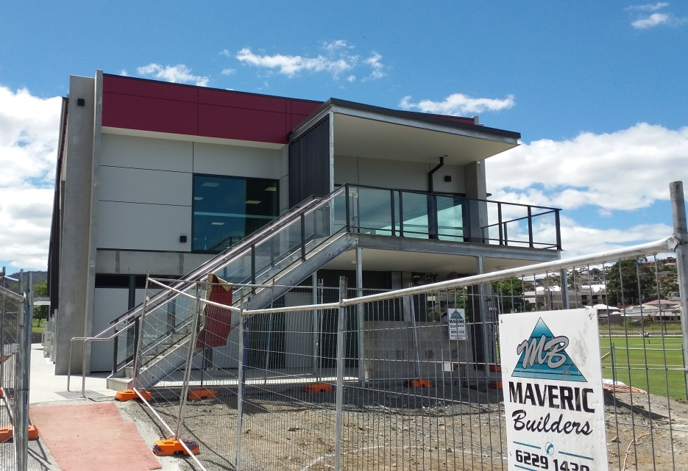
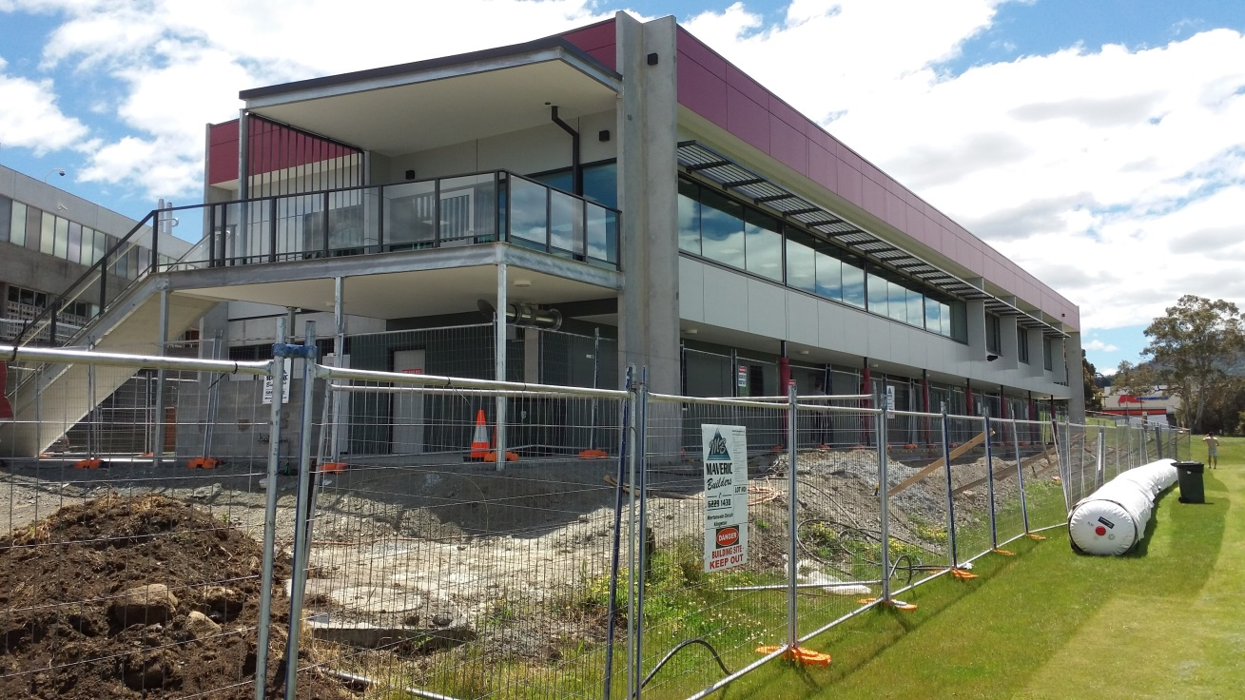
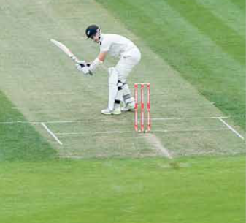
ACTIVE SPORT & RECREATION
Kangaroo Bay Oval Changerooms & Clubroom Facility
Notes:
Despite being in the centre of our city, active recreation remains a major component of the precinct.
A sportsfield change-room and amenities building to support the organised sporting activities is nearing completion.
The upper level of the building will be the home of the Clarence Cricket Club.

Slide 11
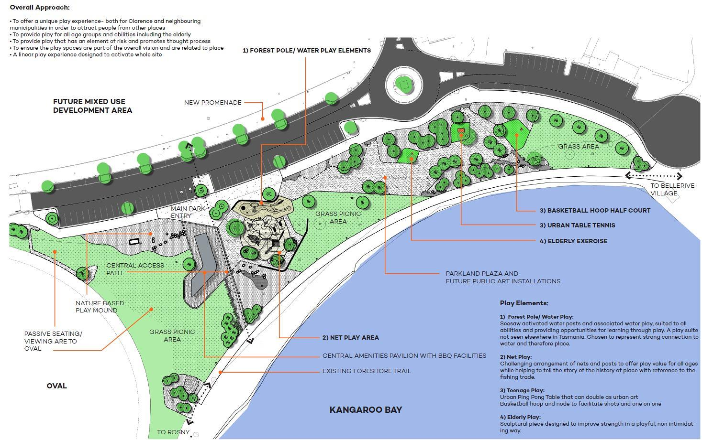
AGE & FAMILY FRIENDLY ACTIVITIES – PASSIVE & ACTIVE
Kangaroo Bay Parklands
Notes:
The Kangaroo Bay Parklands is a very important component of the overall project – and will provide some balance to the other more active sporting activities.
Parklands - approach:
• To offer a unique play experience- both for Clarence and neighbouring municipalities in order to attract people from other places
• To provide play for all age groups and abilities including the elderly
• To provide play that has an element of risk and promotes thought process
• A linear play experience designed to activate whole site
A central component of the parklands is the public BBQ/picnic pavilion and toilets, which includes disabled access facilities, which we hope can be a focus for families.
Public art and interpretation will also be a feature of the new parklands.

Slide 12
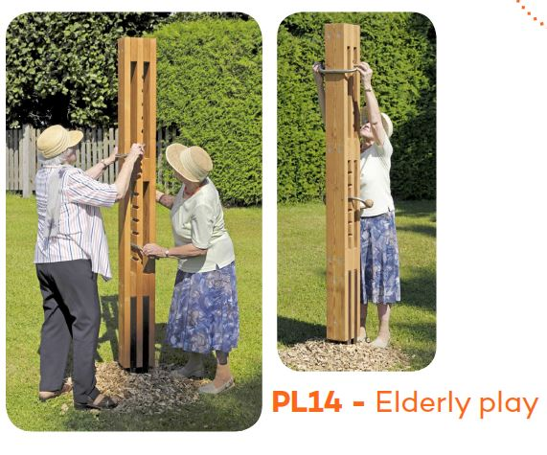
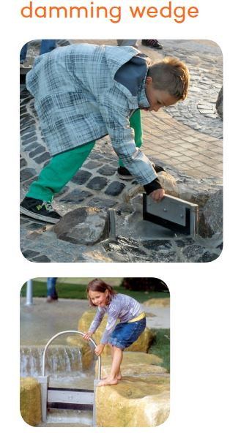
Notes:
If you visit the construction site later you will notice some rather strange looking pieces of equipment.

Slide 13
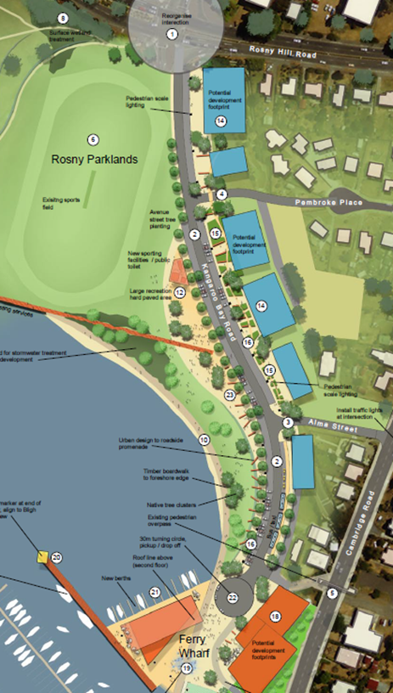
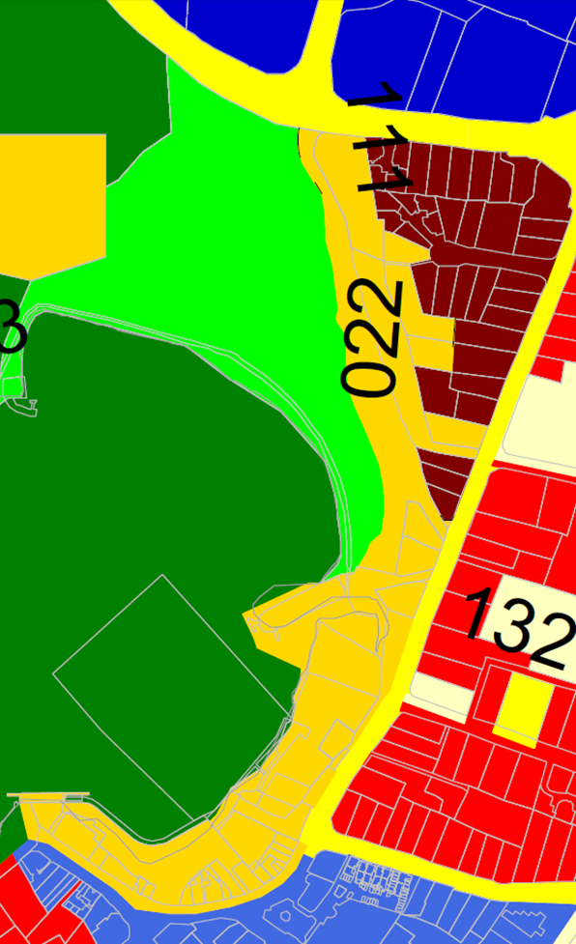
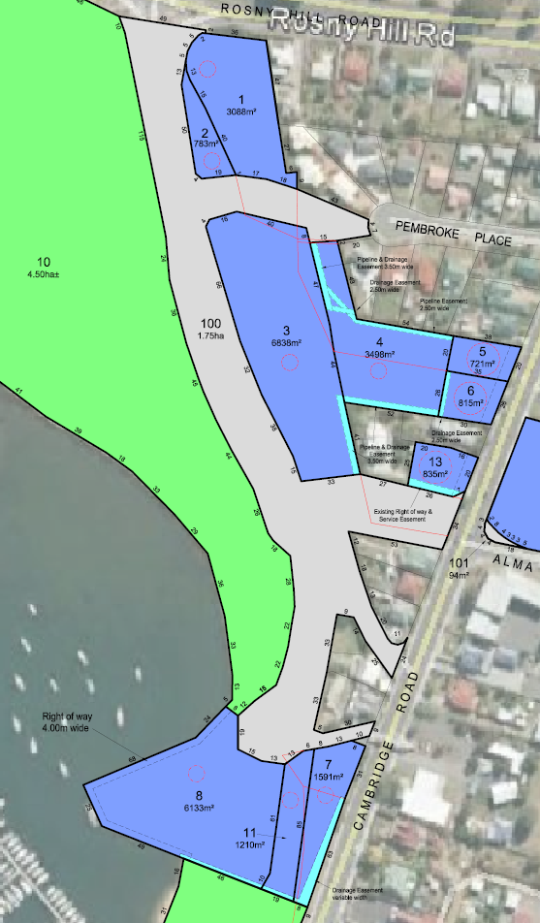
COMMERCIAL DEVELOPMENT
URBAN DESIGN
LAND USE ZONING
SUBDIVISION
Notes:
The introduction of commercial activity into what are considered “public” areas is often controversial – as such it is essential that community consultation occurs.
Our process towards activation the precinct with some commercial hospitality services has involved 3 significant stages – each stage building upon the work of the former.
Council policies in regard to public open space, public amenity, disability access and health & well-being, need to be considered at each stage of the process. This requires a “corporate wide” approach, which is not easy and we are certainly not perfect at it.
The actual development proposals that come forward later are then tested against the development criteria, standards, and policies that have been put in place.

Slide 14
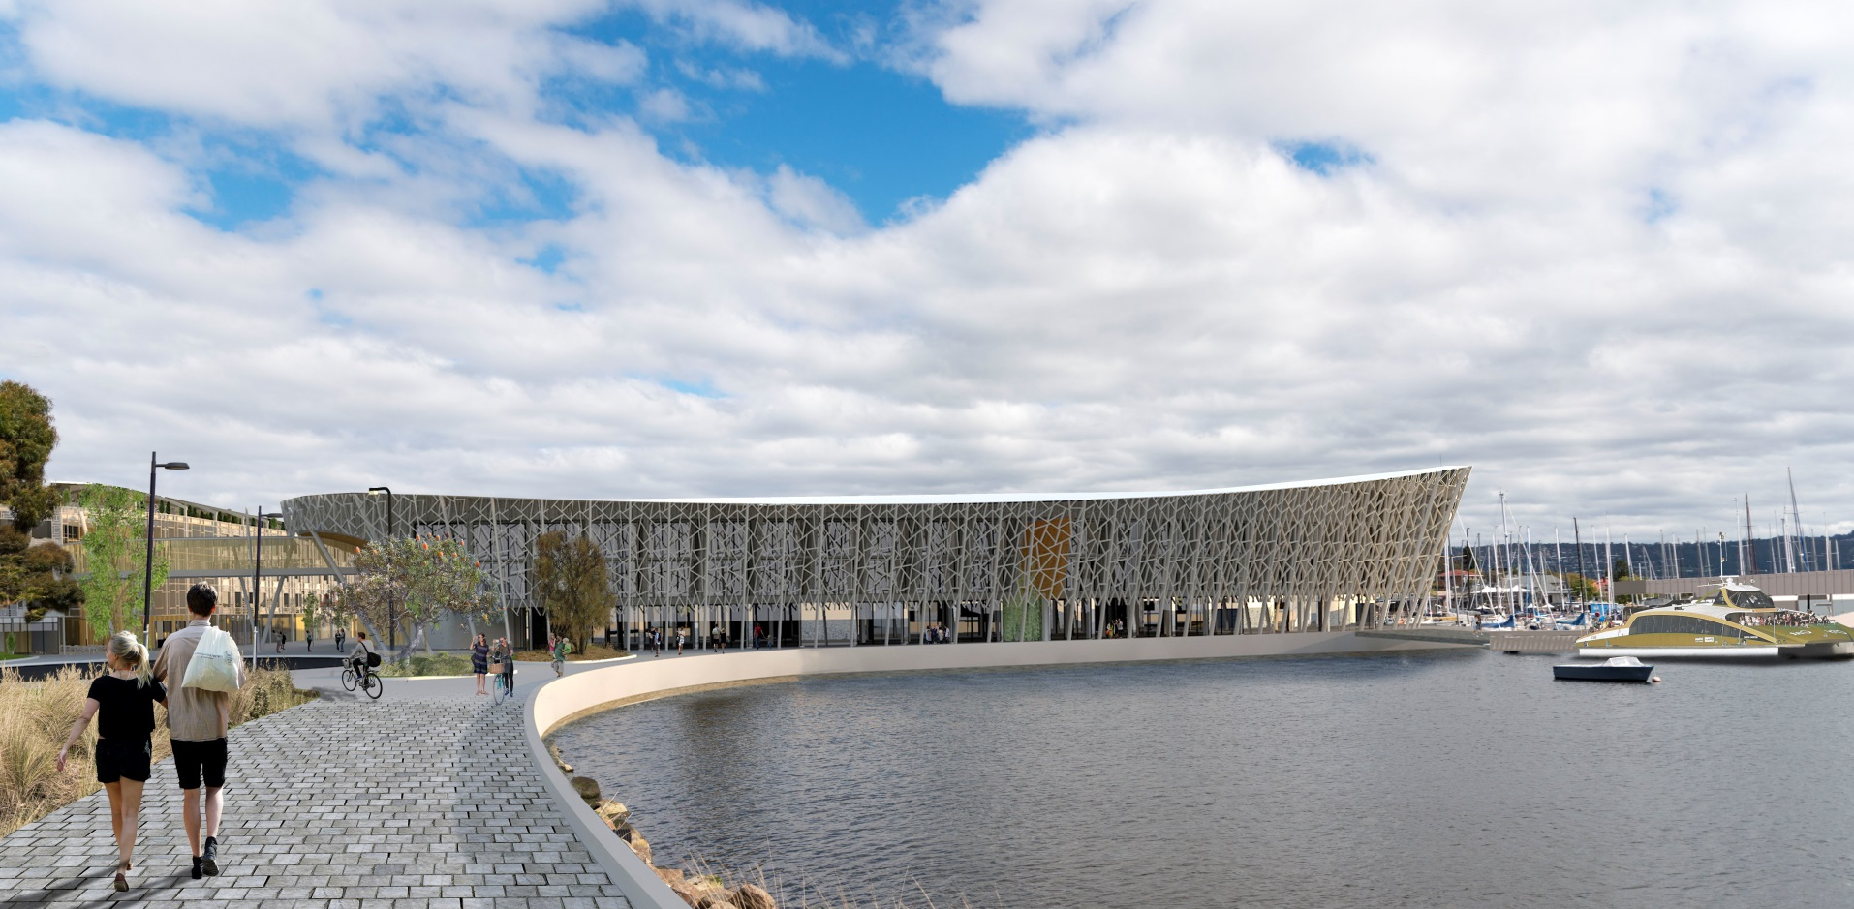
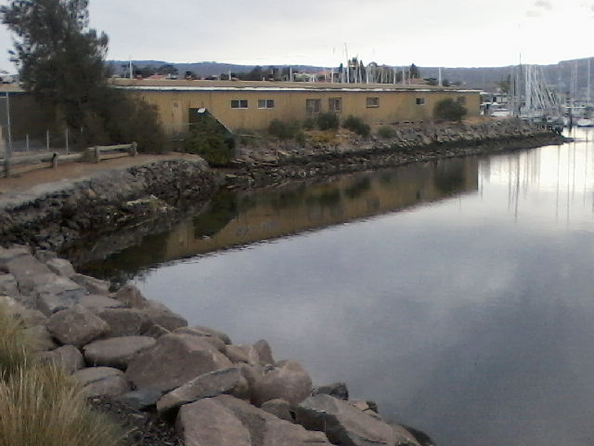
A FOCAL POINT WITHIN THE BAY?
Notes:
To finish I would like to refer back to one of the elements we thought was important and was missing – something iconic as a focal point within the bay.
There is a current proposal for a hotel and hospitality training school – the architectural concept is a “boat shaped” building with a “cracked ice” façade.
The proposal has the potential to provide that focal point – but now needs to be assessed through the statutory approval processes.

Slide 15
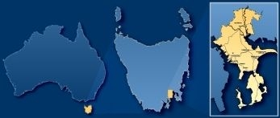
KANGAROO BAY COMMUNITY & ECONOMIC DEVELOPMENT PROJECT
I hope this overview has provided some insight into how Clarence City Council has approached the task of an urban development project in the context of our commitment to being an age friending city that encourages community health and well-being.
Notes:
I hope this overview has provided some insight into how Clarence City Council has approached the task of an urban development project in the context of our commitment to being an age friending city that encourages community health and well-being.

