Slide 1
DPAC LOCAL GOVERNMENT FORUM
“Get Moving Tasmania”
Dan Vautin from Good Sports
With guest appearances
Shae Collis – Northern Rockstar
Els-Mari – Southern Champion

Slide 3
Good Sports program
Evidence shows that community based sporting clubs are a great place for health promotion. Sporting clubs can positively impact their members lives outside of sport, by preventing excessive and underage drinking, binge drinking, illegal drug consumption and promoting positive mental health and healthy food.
The Good Sports program is an initiative of the Alcohol and Drug Foundation to develop safe and healthier communities. The program helps sporting clubs manage alcohol responsibly, reduce harms associated with alcohol and other drugs including tobacco, improve parent and spectator behavior and implementing healthier canteens.

Slide 4
Recent Harvard Study examining healthy habits and longevity
(123,000 volunteers involved)
Discovered that (drum roll please….)
However, it is not a question of science….
You will live longer (a lot longer) IF you
Eat a healthy diet
Control your weight
Exercise moderately and regularly
Consume moderate amounts or no alcohol
Don’t smoke
And we are talking over 12 to 14 years longer
It is a question of WHO is sending the message
Notes:
This study tells us you can live a really long life, and possibly delay or avoid diabetes, heart disease, and enjoy good mental health IF you do all of these things.
And most people with Facebook or a computer know this already.
So why aren’t we healthier? Why aren’t we doing the things we need to do to be healthy?
One factor is WHO is delivering the message : clubs can influence behaviours and Good Sports clubs evolve to become a better WHO delivering these messages.

Slide 5
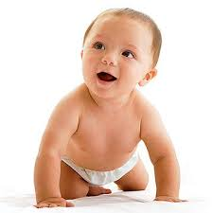
Notes:
Multiple touch-points – clubs can “choose their own adventure”
Funding increase – we are funded to get the job done and are highly motivated to do so.
Free for clubs to do
More than 60% of adult Aussie are obese
1 in 4 kids are obese and this is set to rise further
Suicide is the biggest killer of people under 25 and for men under 40
Mental illness is increasing, with people feeling more stressed and less supported than ever before
Alcohol consumption amongst young people is on the decrease, but is still a massive public health issue with 20% of drinkers accounting for over 70% of consumption. Binge drinking is still a big issue, and there are over 5000 ED presentations each year in Tas due to alcohol (likely under-reported due to data issues)
Illegal drugs, especially ICE, prescription drugs and cannabis are a problem in Tasmania, with new ‘designer drugs’ on the way (and watch out for Fentanyl ☹)

Slide 6
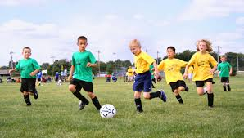
Good Sports aims to:
Highlight the clubs important role within the community
Help clubs serve and sell alcohol within the law
Reduce alcohol related problems including binge and underage drinking, violence and drink driving
Reducing harm of tobacco and illegal drugs
Challenging the normal canteen model
Improving parent and spectator behavior
Enable clubs to meet their duty of care obligations
Promote mental health and help-seeking
Increase club membership and participation in local sporting clubs
Notes:
Association obligation that parents coaches players you need to be responsible in your netball club, especially around alcohol Tabaco and other drugs.
Clubs can be on a scale, with some clubs modelling poor behaviours and others being outstanding role models
Councils should be making sure the clubs who use their facilities are at least modelling the right behaviours or having the conversation” with Good Sports

Slide 7
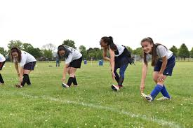
Benefits of Good Sports
A healthier and inclusive club culture which is welcoming of families and juniors
More attractive to sponsors
New and diverse revenue streams
Increase in membership, volunteers and players
Improved relations with your local council and the police
Improved public image
Reduction of club liability risk
Applications for funding and grants are strengthened
Generate community support and respect
It is free of charge through government funding support
Notes:
These benefits are from our RCT studies.
Clubs that truly look at themselves as community organisations, and examine HOW they interact with their community, and what they stand for, tend to be more successful. As Jackson (AFL Tas) recently sent said to me, “the most successful clubs are the clubs that also work to help their members around mental health, are responsible around alcohol and drugs, and show genuine care for the players”.

Slide 8
Smoking policy and complying with smoking regulations
Alcohol policies covering proving, functions, promotion and so forth
Safe transport policies
Spectator policies
Health and wellness policies
Healthy eating policies
Illegal drug policies
Water promotion
Healthy food promotion (greater than 30% of menu)
Social media campaigns to promote mental health
RSA training and incident registers
Banning drinking games, all you can drink functions
Reduce “unhealthy alcohol promotion”
Stop club officials from being photographed drinking alcohol on Facebook
Posters, materials, educational forums, seminars, workshops…
Inviting 3rd party organisations to engage - collaboration
We work across many different engagements within clubs to achieve cultural change over time.
Notes:
And this is just a teaser…we do a lot more.
Always developing new ways to promote health
Clubs don’t do all of this at once…..it is about an evolution of behaviour….primary prevention is a long game

Slide 9
LEADS TO…
Increased
Club’s social standing in the community
Sponsorship and funding opportunities
Diversified revenue streams
Reduced
Club participation
Risky and harmful drinking
Smoking
Risk of liability
Drink-driving
Bullying, stigma, discrimination
Illegal drug use
Notes:
By the time the average Good Sports club reaches Level 3:
40% increase in under 18s
50% increase in females
70% increase in spectators
RCT examining High Risk AFL in Vic 2008

Slide 10
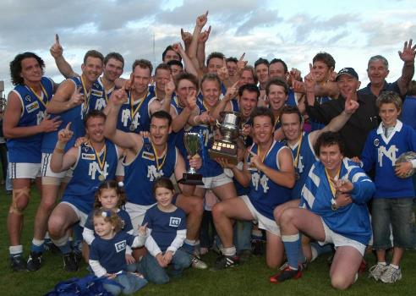
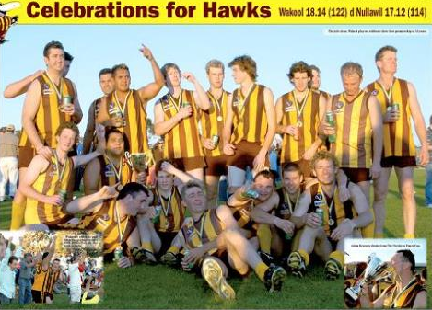
GOOD SPORTS?
Notes:
Question the participants which image best portrays a good sports club…if any and why
Points to note and discuss:
The appearance of the club members as unified in the left picture vs the right (standing close together, all undertaking the same actions as opposed to the right where they are all doing their own thing and appear fragmented)
The inclusion of children into the photo in LHS vs RHS
Drinking from the cup in the RH pic and how this looks to outsiders
The tin beer cans in each persons hand in the RH pic and how that looks as opposed to those in the LH pic
Note that not all team members and coaches/support are included in the RH picture -> again does not show a unified club (visual appearance)
The RH pic, they all look like they are doing their own thing and not standing close, alcohol affecting their need for personal space and or disorientation?
Note in the LH pic they are holding the trophy whereas it is being drunk out of in the RH pic, respect for the club, sport and award.

Slide 11
THE GOOD SPORTS PROGRAM
POLICIES MATTER
Notes:
Discuss RCT and KPMG Reports
Stickability – what we do works and continues to be in place when committee’s change
Role Modelling – is the key to changing hearts and minds
Slide notes:
Research conducted by KPMG shows Good Sports saves the community and government millions of dollars a year treating alcohol-related harms.
Investment in prevention is money well spent. KPMG research shows that for every $1 invested in Good Sports clubs leads to more than $4 saved in alcohol-related harm.

Slide 12
What are councils doing around Australia?
Examples include
All clubs leasing space MUST be ACCREDITED as part of tenancy agreement
All clubs with Liquor Licenses must be accredited
Clubs wishing to book are part of ratings matrix of which Good Sports is a part of the process
Newcastle City Council provides $5,500 to GS each year and all clubs in LGA must be accredited (provide certificate)
Blanket bans on alcohol on or near sports grounds
All clubs must have alcohol and illegal drugs policy
Clubs must be registered with Good Sports (council confirm with Good Sports)
Financial discounts on hire – if you’re Good Sports its cheaper than if your not
Mayor is the independent nominee
Notes:
Leasing Council sporting facilities
Sydney and Central NSW Coast:
Mandatory for all clubs to be accredited: Councils such as Sutherland, Liverpool and Waverley require clubs to be Good Sports accredited as a condition to hire grounds
Mandatory for clubs with liquor licenses to be accredited: Gosford and Wyong Councils require any clubs selling alcohol & with a license to be Good Sports accredited to hire grounds
Accreditation used to compare clubs requesting booking: Marrickville Council have developed a matrix, of which Good Sports accreditation is one criteria, with each criteria being given a certain rating. The matrix is used to compare requests for the same venue. Hence, a club with Good Sports accreditation is more likely to have access to a ground
Newcastle City Council:
Good Sports has a Community Partnership contract with the Council – they provide a $5500 grant to Good Sports each year
All sporting clubs that use Council grounds or facilities within the LGA must be Good Sports accredited (need to provide a copy of the club’s Good Sports current accreditation certificate).
Albury City Council (clauses included in their sporting facilities lease agreement):
Clubs that have an active history of participating in community events, proactively developing the club culture and participating in community programs such as Good Sports will be looked upon favourably in the allocation process.
No alcohol is to be consumed on the playing surface while participating in the use of an Albury City sporting facility. Albury City encourages clubs to become members of community programs such as Good Sports. It is also recommended that clubs take a proactive approach and implement drug and alcohol policies and programs to ensure their club promotes a healthy lifestyle to the community.
Gosford City Council (clause included in their sportsground information/ground hire booklet)
Liquor Licensing
In order to be considered for approval Clubs should be registered with the Good Sports organisation which is an initiative by the Australian Drug Foundation to assist Sporting Organisations to implement responsible alcohol management practices. Involvement with the organisation is free and will assist your club to manage alcohol responsibly and provide a safe environment for your members and visitors. In turn this creates a more positive community image of the club, encouraging more people to become involved thus generating more diverse streams of revenue for the club. Information is available at http://www.goodsports.com.au/
Liverpool City Council (clause included in their HIRE OF PLAYING SURFACES POLICY)
All seasonal hirers are required to become accredited by the Good Sports Program from 1 September 2010, unless informed by Council they are exempt. The Good Sports Program is a State Government Initiative assisting sporting clubs to become safe, healthy and family friendly members of the community through responsible service and consumption of alcohol. It is an initiative of the Australian Drug Foundation supported by Council and the NSW Roads and Traffic Authority.
Other state examples:
Victoria:
Some councils offer a financial discount on hire fees but to receive discount must be Good Sports accredited.
Many councils included in their tenancy agreements “the council highly recommends joining the Good Sports program”.
Northern Territory (Darwin, Palmerston, Katherine and Alice Springs):
Any Club holding a lease must be Good Sports accredited.
The Mayor in each town is the Independent Nominee for the Good Sports clubs in their jurisdiction

Slide 13
What are we shooting for with Tassie councils?
Our vision is to create GOOD SPORTS Councils
Make it a condition of lease/license or tenancy/user agreement that clubs must be REGSITERED with Good Sports in some way.
This tells you that the club is engaged with Good Sports in some way. It means they are at least “having the conversation”.
Notes:
If 19 year old international students and UTAS can see the value of obligating clubs to be part of Good Sports, surely councils can equally find their way to supporting this approach.
Council usually had CDO’s, Sports reps, youth services, property managers…the infrastructure and ability to support the Good Sports approach exist. And most councils have their own community action plans or strategic health plans that Good Sports feeds into.
It’s a tick box. Are you registered with Good Sports (Yes/No)? Simple. A no brainer really!

Slide 14
Other ways you can support.
Hold Good Sports forums and invite club leadership to attend – have Good Sports as a guest speaker
Add a reference to Good sports on all grant applications, suggesting favourable consideration for those who are engaged with Good Sports
Promote Good Sports through your networks / website

Slide 15
OUR GOAL in 2018
10 councils in Tasmania make it a condition that all clubs who use council facilities be “registered” with Good Sports
Are you going to be one of the ten?

Slide 16
Letterhead
Business cards
Newsletters
Event posters
Emails
Facebook
Website
Membership form
Members booklet
Game day book
What you will receive
http://goodsports.com.au/club-resources

Slide 17
Dan Vautin
Regional Community Development Manager
daniel.Vautin@adf.org.au
Tel: 0427 123 717

